Slide 1
B09S0061 Software Engineering
Lecture 10
Instructor: Liu, Guangchi Ph.D.
2025/05/09
Notes:
本模板基于“中国科学院大学-路人丁-PPT模板”魔改而成，著作权归该作者所有。
本模板中使用的东南大学校徽、校标文字组合、校训文字等素材来自于微信公众号“金木屋”。
本模板的视觉设计参考了“东南大学视觉识别系统”。
人物介绍页头像素材来自 小肥柴。
本模板力求简洁，布局合理，主次分明。以学术风为设计理念，适用于学术报告与论文答辩等相关应用场景。模板未使用任何动画效果。
您仅可以以个人非商业用途使用本PPT模板，不可将信息内容的全部或部分用以出售，或以出租、出借、转让、分销、发布等其他任何方式供其他人使用。
欢迎 持续关注东南大学止于至善学术风 PPT 模板 （https://zhuanlan.zhihu.com/p/335298500）后续的功能优化及多语言更新版本。
最后，祝汇报顺利，马到成功！
Version: (2021) v1.5-en.

Slide 2
Heads Up
3rd Assignment has ben uploaded to 微助教， Due on Next Monday （May 12th）， 23:55 pm

Slide 3
Heads Up
3rd Lab: May 17th (Saturday), 14:00 – 17:25, J6-102

Slide 4
Heads Up
Prepare the following questions (10 pts for each question )
Q1 Which IDE is used in your project ?
Q2 Any advanced IDE used in your project?
Q3 Did you use any existing packages or components in your project?
Q4 What is the benefit of using these framework or components?
Q5 What is the class diagram of your project like?
Q6 What is the object diagram of your project like?
Q7 What is the sequence diagram of your project like?
Q8 Any design pattern used in your project?
Q9 How will you handle changes of components or extended features in the future?
Q10 How will you handle legacy code as the project iterates?

Slide 5
01
PART ONE
Reliability

Slide 6
Bugs, Faults, and Failures
Bug (fault):
Programming or design error whereby the delivered system does not conform to specification (e.g., coding error, protocol error)
Failure:
Software does not deliver the service expected by the user (e.g., mistake in requirements, confusing user interface)

Slide 7
Terminology
Fault avoidance
Build systems with the objective of creating fault-free (bugfree) software.
Fault detection (testing and verification)
Detect faults (bugs) before the system is put into operation or when discovered after release.
Fault tolerance
Build systems that continue to operate when problems (bugs, overloads, bad data, etc.) occur.

Slide 8
Failure of Requirements
Year 2000 Problem
Many programs developed before 2000 simply prefix "19" to the year of a date, allowing them to only store the last two digits of the year instead of four.
The problem started because on memory was expensive at that time.
These strategies saved money by reducing the size of stored data files and databases in exchange for becoming unusable past the year 2000

Slide 9
Failures: A Case Study
A passenger ship with 1,509 persons on board grounded on a shoal near Nantucket Island, Massachusetts. At the time the vessel was about 17 miles from where the officers thought they were. The vessel was on a route from Bermuda to Boston.

Slide 10
Case Study: Analysis
From the report of the National Transportation Safety Board:
The ship was steered by an autopilot that relied on position information from the Global Positioning System (GPS).
If the GPS could not obtain a position from satellites, it provided an estimated position based on Dead Reckoning (distance and direction traveled from a known point).
The GPS failed one hour after leaving Bermuda.
The crew failed to see the warning message on the display (or to check the instruments).
34 hours and 600 miles later, the Dead Reckoning error was 17 miles.

Slide 11
Case Study: Software Lessons
All the software worked as specified (no bugs), but ...
After the GPS software was specified, the requirements changed (stand alone system now part of integrated system).
The manufacturers of the autopilot and GPS adopted different design philosophies about the communication of mode changes.
The autopilot was not programmed to recognize valid/invalid status bits in messages from the GPS.
The warnings provided by the user interface were not sufficiently conspicuous to alert the crew.
The officers had not been properly trained on this equipment.
Reliable software needs all parts of the software development process to be carried out well.

Slide 12
Key Factors for Reliable Software
Organization culture that expects quality. This comes from the management and the senior technical staff.
Precise, unambiguous agreement on requirements.
Design and implementation that hides complexity (e.g., structured design, object-oriented programming).
Programming style that emphasizes simplicity, readability, and avoidance of dangerous constructs. https://google.github.io/styleguide/
Software tools that restrict or detect errors (e.g., strongly typed languages, source control systems, debuggers).
Systematic verification at all stages of development, including requirements, system architecture, program design, implementation, and user testing.
Particular attention to changes and maintenance.

Slide 13
Building Dependable Systems: Organizational Culture
Good organizations create good systems:
Managers and senior technical staff must lead by example.
Acceptance of the group's style of work (e.g., meetings, preparation, support for juniors).
Visibility.
Completion of a task before moving to the next (e.g., documentation, comments in code).

Slide 14
Building Dependable Systems: Organizational Culture
Example: a library consortium
The problem:
Database crashed repeatedly, losing data.
Successive releases failed to fix the problem.
Analysis:
Team had a good technical plan, but needed time.
Senior management insisted on releases before they were ready.
The fix:
Give the team time.
Change the senior management.

Slide 15
Building Reliable Software: Quality Management Processes
Assumption:
Good software is impossible without good processes
The importance of routine:
Standard terminology (requirements, design, acceptance, etc.)
Software standards (coding standards, naming conventions, etc.)
Regular builds of complete system (often daily)
Internal and external documentation
Reporting procedures
This routine is important for both heavyweight and lightweight development processes.

Slide 16
Building Reliable Software: Quality Management Processes
When time is short...
Pay extra attention to the early stages of the process: feasibility, requirements, design.
If mistakes are made in the requirements process, there will be little time to fix them later.
Experience shows that taking extra time on the early stages will usually reduce the total Ime to release.

Slide 17
Building Reliable Software: Communication with the Client
A system is no use if it does not meet the client's needs
The client must understand and review the agreed requirements in detail.
It is not sufficient to present the client with a specification document and ask him/her to sign off.
Appropriate members of the client's staff must review relevant areas of the design (including operations, training materials, system administration).
The acceptance tests must belong to the client.

Slide 18
Building Reliable Software: Complexity
The human mind can encompass only limited complexity:
Comprehensibility
Simplicity
Partitioning of complexity
A simple component is easier to get right than a complex one.

Slide 19
Building Reliable Software: Change
Changes can easily introduce problems
Change management
Source code management and version control
Tracking of change requests and bug reports
Procedures for changing requirements specifications, designs and other documentation
Regression testing (discussed later)
Release control
When adding new functions or fixing bugs it is easy to write patches that violate the systems architecture or overall program design. This should be avoided as much as possible. Be prepared to modify the architecture to keep a high quality system.

Slide 20
Building Reliable Software: Fault Tolerance
Aim:
A system that continues to operate when problems occur.
Examples:
Invalid input data (e.g., in a data processing application)
Overload (e.g., in a networked system)
Hardware failure (e.g., in a control system)
General Approach:
Failure detection
Damage assessment
Fault recovery
Fault repair

Slide 21
Fault Tolerance: Recovery
Backward recovery
Record system state at specific events (checkpoints). After failure, recreate state at last checkpoint.
Combine checkpoints with system log (audit trail of transactions) that allows transactions from last checkpoint to be repeated automatically.
Recovery software is difficult to test
Example
After an entire network is hit by lightning, the restart crashes because of overload. (Problem of incremental growth.)

Slide 22
Building Reliable Software: Small Teams and Small Projects
Small teams and small projects have advantages for reliability:
Small group communication cuts need for intermediate documentation, yet reduces misunderstanding.
Small projects are easier to test and make reliable.
Small projects have shorter development cycles. Mistakes in requirements are less likely and less expensive to fix.
When one project is completed it is easier to plan for the next.
Improved reliability is one of the reasons that agile development has become popular over the past few years.

Slide 23
Reliability Metrics
Reliability
Probability of a failure occurring in operational use.
Traditional measures for online systems
Mean Ime between failures
Availability (up time)
Mean time to repair
Market measures
Complaints
Customer retention

Slide 24
Reliability Metrics for Distributed Systems
Traditional metrics are hard to apply in multi-component systems:
A system that has excellent average reliability might give terrible service to certain users.
In a big network, at any given moment something will be giving trouble, but very few users will see it.
When there are many components, system administrators rely on automatic reporting systems to identify problem areas.

Slide 25
Metrics: User Perception of Reliability
Perceived reliability depends upon:
user behavior
set of inputs
pain of failure
User perception is influenced by the distribution of failures
A personal computer that crashes frequently, or a machine that is out of service for two days every few years.
A database system that crashes frequently but comes back quickly with no loss of data, or a system that fails once in three years but data has to be restored from backup.
A system that does not fail but has unpredictable periods when it runs very slowly.

Slide 26
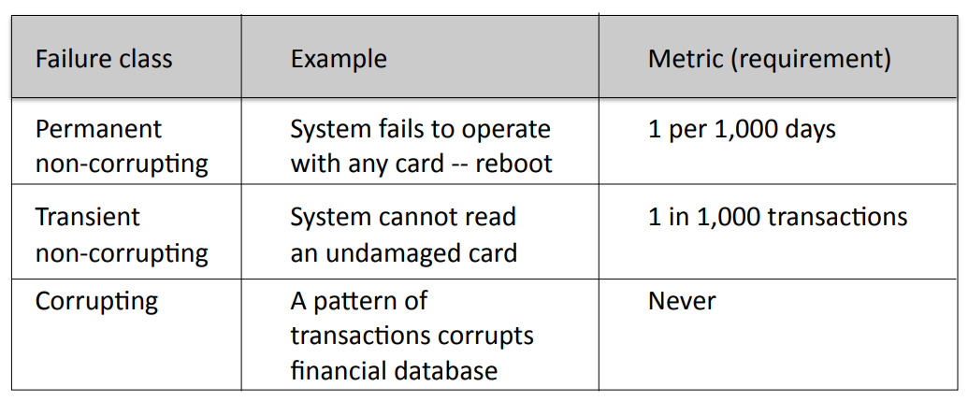
Reliability Metrics for Requirements
Example: ATM card reader

Slide 27
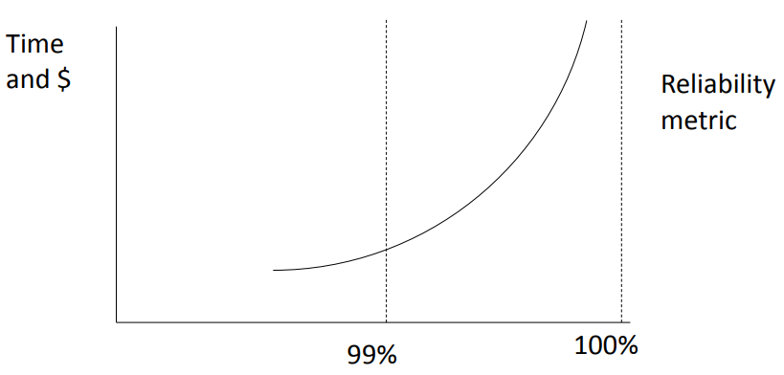
Metrics: Cost of Improved Reliability
Example.
Many supercomputers average 10 hours productive work per day. How do you spend your money to improve reliability?

Slide 28
Example: Central Computing System
A central computer system (e.g., a server farm) is vital to an entire organization (e.g., an Internet shopping site). Any failure is serious.
Step 1: Gather data on every failure
Create a database that records every failure
Analyze every failure:
hardware
software (default)
environment (e.g., power, air conditioning) human (e.g., operator error)

Slide 29
Example: Central Computing System
Step 2: Analyze the data
Weekly, monthly, and annual statistics
Number of failures and interruptions
Mean time to repair
Graphs of trends by component, e.g.,
Failure rates of disk drives
Hardware failures after power failures
Crashes caused by software bugs in each component
Categories of human error

Slide 30
Example: Central Computing System
Step 3: Invest resources where benefit will be maximum, e.g.,
Priority order for software improvements
Changed procedures for operators
Replacement hardware
Orderly restart after power failure

Slide 31
02
PART TWO
Verification, Testing, and Bugs

Slide 32
Building Reliable Systems: Two Principles
For a software system to be reliable:
Each stage of development must be done well, with incremental verification and testing.
Testing and correction do not ensure quality, but reliable systems are not possible without thorough testing.

Slide 33
Static and Dynamic Verification
Static verification:
Techniques of verification that do not include execution of the software.
• May be manual or use computer tools.
Dynamic verification:
Testing the software with trial data.
Debugging to remove errors.

Slide 34
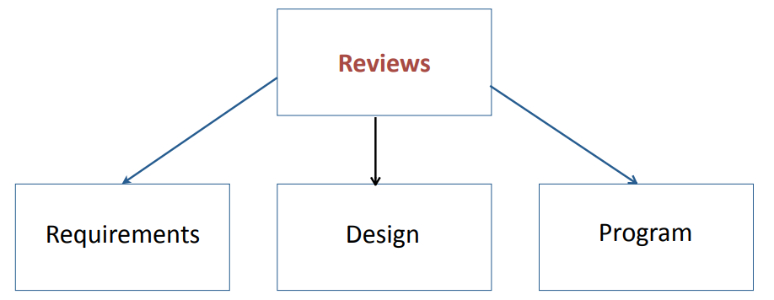
Static Verification: Reviews
Reviews are a form of static verification that is carried out throughout the software development process.

Slide 35
Reviews
Reviews are a fundamental part of good software development
Concept
Colleagues review each other's work:
can be applied to any stage of software development, but particularly valuable to review program design or code
can be formal or informal
Preparation
The developer(s) provides colleagues with documentation (e.g., models, specifications, or design), or code listing.
Participants study the materials in advance.
Meeting
The developer leads the reviewers through the materials, describing what each section does and encouraging questions.

Slide 36
The Review Meeting
A review is a structured meeting
Participants and their roles:
Developer(s): person(s) whose work is being reviewed
Moderator: ensures that the meeting moves ahead steadily
Scribe: records discussion in a constructive manner
Interested parties: other developers on the same project
Outside experts: knowledgeable people who are not working on this project
Client: representatives of the client who are knowledgeable about this part of the process

Slide 37
Benefits of Reviews
Benefits:
Extra eyes spot mistakes, suggest improvements.
Colleagues share expertise; helps with training.
Incompatibilities between components can be identified.
Gives developers an incentive to tidy loose ends.
Helps scheduling and management control.

Slide 38
Successful Reviews
To make a review a success:
Senior team members must show leadership.
Good reviews require good preparation by everybody.
Everybody must be helpful, not threatening.
Allow plenty of time and be prepared to continue on another day.

Slide 39
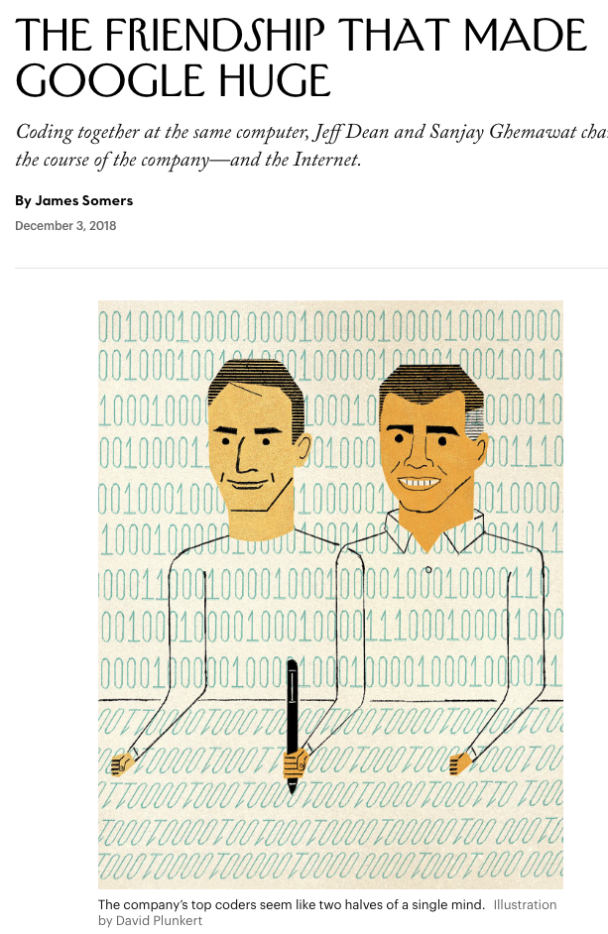
Static Verification: Pair Design and Pair Programming
Concept: achieve benefits of review by shared development
Two people work together as a team:
design and/or coding
testing and system integration
documentation and hand-over
Benefits include:
two people create better software with fewer mistakes
cross training
Many software houses report excellent productivity.

Slide 40
Static Verification: Program Inspections
Formal program reviews whose objective is to detect faults:
Code is read or reviewed line by line
150 to 250 lines of code in 2 hour meeting
Use checklist of common errors
Requires team commitment, e.g., trained leaders
So effective that it is claimed that it can replace unit testing.

Slide 41
Static Verification: Analysis Tools
Program analyzers scan the source of a program for possible errors and anomalies.
Control flow: Loops with multiple exit or entry points
Data use: Undeclared or uninitialized variables, unused variables, multiple assignments, array bounds
Interface faults: Parameter mismatches, non-use of functions results, uncalled procedures
Storage management: Unassigned pointers, pointer arithmetic

Slide 42
Static Analysis Tools (continued)
Static analysis tools
Cross-reference table: Shows every use of a variable, procedure, object, etc.
Information flow analysis: Identifies input variables on which an output depends.
Path analysis: Identifies all possible paths through the program.

Slide 43
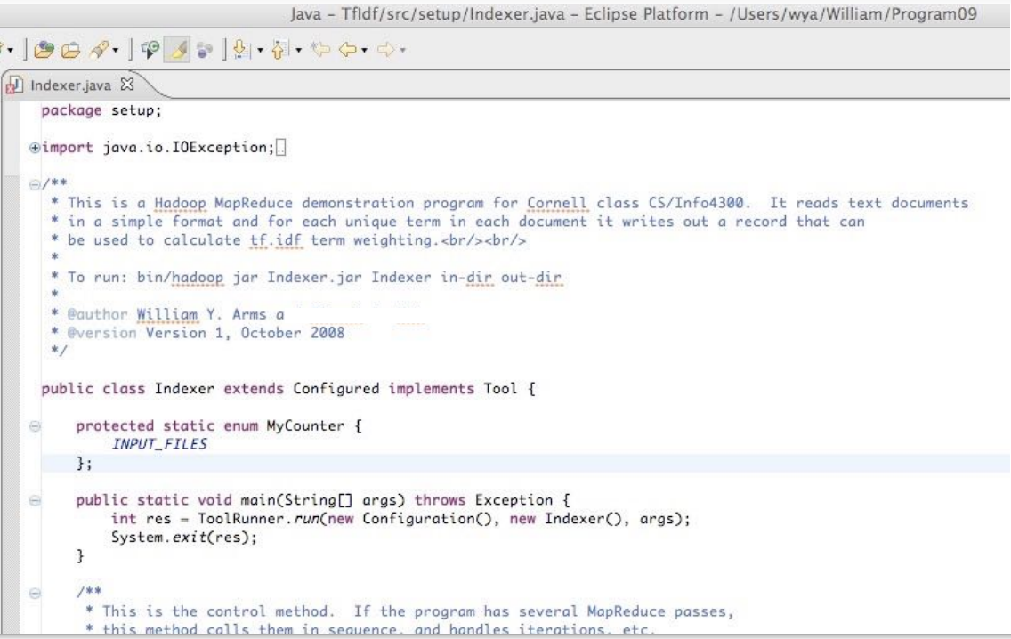
Static Analysis Tools in Programming Toolkits

Slide 44
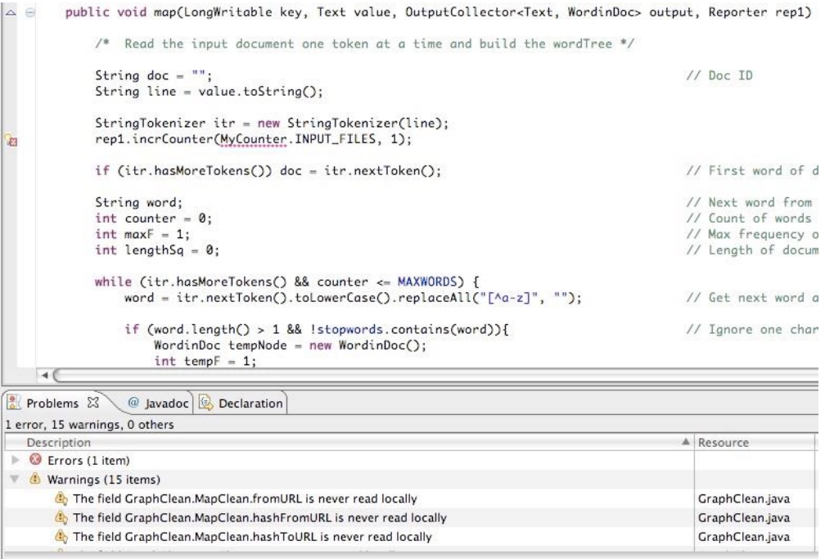
Static Analysis Tools in Programming Toolkits

Slide 45
Dynamic Verification
Dynamic Verification
Execute programmed code with a given set of test cases

Slide 46
Dynamic Verification
Testing is most effective if divided into stages
User interface testing (carried out separately)
Unit testing
unit test
System testing
integration test
function test
performance test
installation test
Acceptance testing (carried out separately)

Slide 47
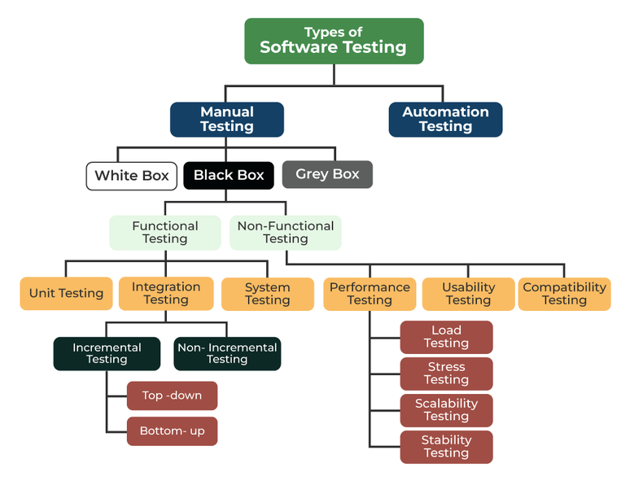
Types of Software Testing

Slide 48
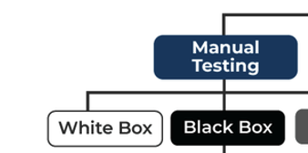
Terminologies
White/Glass/Open Box Testing
Involves testing the internal structure and workings of a software application.
Tester has access to the source code and uses this knowledge to design test cases
Task owner
Black/Box Testing
Tester is not concerned with the internal knowledge or implementation details of the software
Focuses on validating the functionality based on the provided specifications or requirements
Third party tester

Slide 49
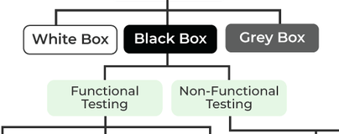
Terminologies
Functional Testing
Test against the functional requirements and specifications
Unit Test/Integration Test/System Test/Smoke Test
Non-Functional Testing
Test against the non-functional requirements and specifications
Performance, Usability, Security, etc.

Slide 50
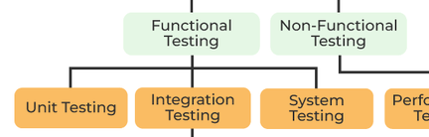
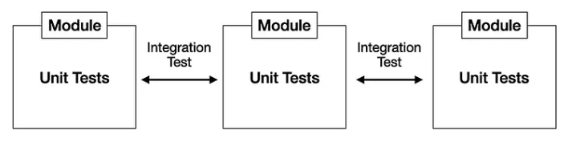
Terminologies
Unit Test
Testing individual units or components of a software application
Test data is usually chosen by developer(s) based on their understanding of specification and knowledge of the unit.
Created by the developer(s) of the unit or by special testers.
Integration Test
Testing units or components of a software application interact with each other
Incremental Test/Non-incremental Test (Big Bang Test)
System Test
Testing that evaluates the overall functionality and performance of a complete and fully integrated software solution

Slide 51
Unit Test Design
Testing can never prove that a system is correct.
It can only show that either (a) a system is correct in a single case, or (b) that it has an error.
The objective of testing is to find errors or demonstrate that program is correct in specific instances.
Testing is never comprehensive.
Testing is expensive.

Slide 52
Test Cases
Test cases are specific tests that are chosen because they are likely to find specific problems.
Test cases are chosen to balance expense against chance of finding serious errors.
Cases chosen by the development team are effective in testing known vulnerable areas.
Cases chosen by experienced outsiders and clients will be effective in finding gaps left by the developers.
Cases chosen by inexperienced users will find other errors.
Test coverage are ways to measure "how much code" was tested
Statement (line) coverage
Branch coverage
Path coverage
…

Slide 53
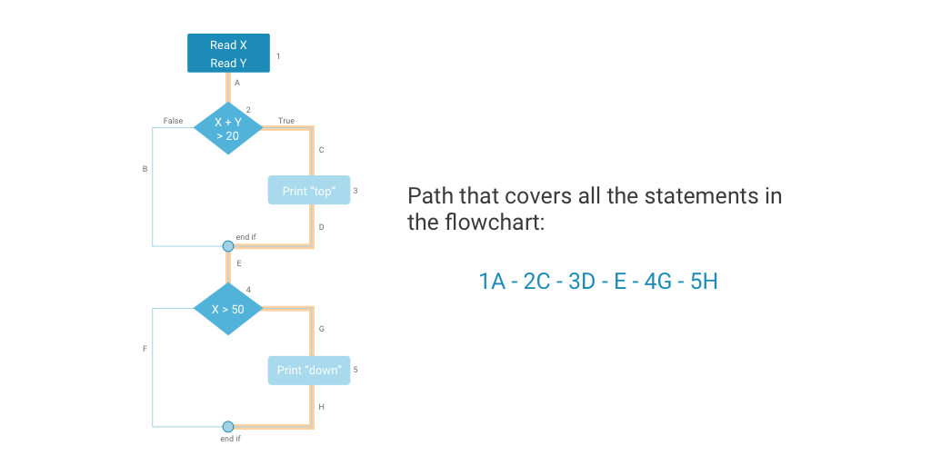
Statement Coverage

Slide 54
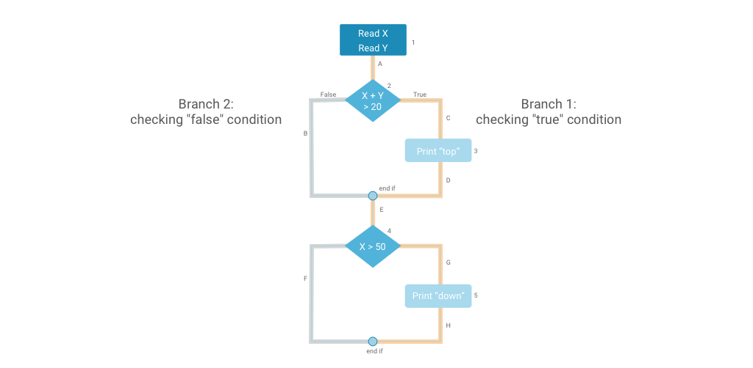
Branch Coverage

Slide 55
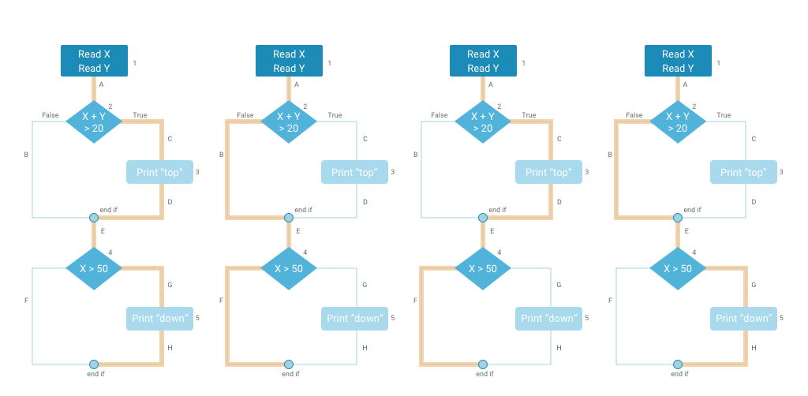
Path Coverage

Slide 56
Fuzz Test
Give program random input, look for crashes, assertion violations
Increased in popularity in 2010s; very effective at finding security vulnerabilities
Can be enhanced with coverage feedback (construct input that exercises particular branches)
Use genetic algorithms,
neural networks

Slide 57

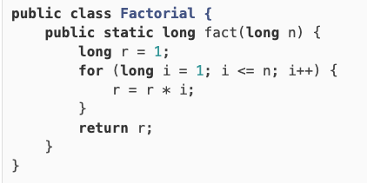
Unit Test: A Java Example

Slide 58
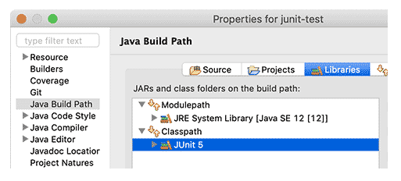
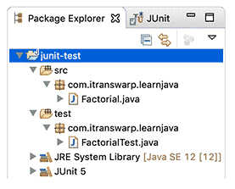
Unit Test: A Java Example

Slide 59
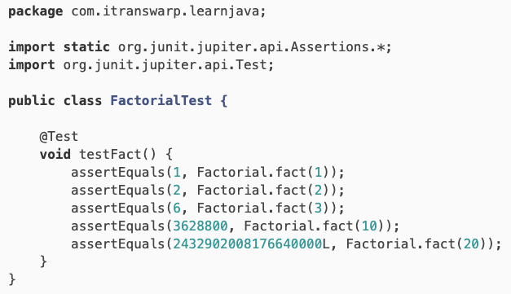
Unit Test: A Java Example

Slide 60
Unit Test: A Java Example
Run unittest with command line
$ javac -d target -cp target:junit-platform-console-standalone-1.7.2.jar /Path/to/Folder/FactorialTest.java
$ java -jar junit-platform-console-standalone-1.7.2.jar --class-path target --select-class Path.to.Folder.FactorialTest.java
Run unittest with Maven as build tool
$ mvn test -Dtest= FactorialTest

Slide 61
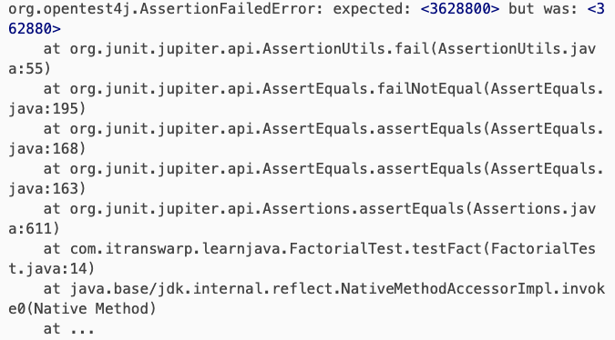
Unit Test: A Java Example

Slide 62
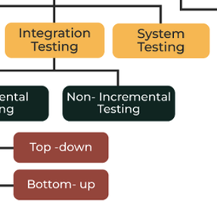
System and Integration Test
Tests on components or complete system, combining units that have already been thoroughly tested.
Emphasis on integration and interfaces.
Trial data that is typical of the actual data, and/or stresses the boundaries of the system, e.g., failures, restart.
Carried out systematically, adding components until the entire system is assembled.
Can be black or white box: by development team or by special testers.
System testing is finished fastest if each component is completely debugged before assembling the next.

Slide 63
Incremental Testing (e.g., Daily Testing)
Spiral development and incremental testing
Create a first iteration that has the structure of the final system and some basic functionality
Create an initial set of test cases
Check-in changes to the system on a daily basis, rebuild entire system daily
Run a comprehensive set of test cases daily, identify and deal with any new errors
Add new test cases continually
Many large software houses, e.g., Microsoft, follow this procedure with a daily build of the entire system and comprehensive sets of test cases. For a really big system this may require hundreds or even thousands of test computers and a very large staff of testers.

Slide 64
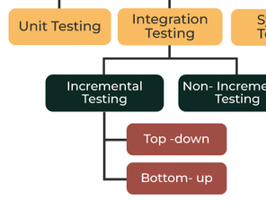
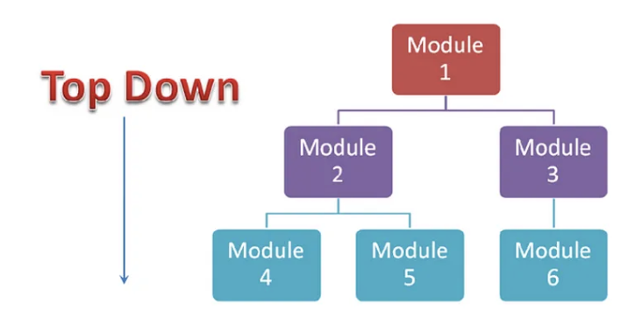
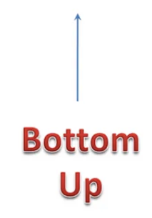
Terminologies
Bottom-up testing
Each unit is tested with its own test environment. Used for all systems.
Top-down testing
Large components are tested with dummy stubs. Particularly useful for:
user interfaces
work-flow
client and management demonstrations

Slide 65
Incremental Testing: an Example
Example
A calendar package consisting of a several modules
Starting point
A prototype with a good overall structure, and most of the functionality, but hastily coded and not robust.
Approach
On a daily cycle:
Design and code one small part of the package
e.g., an interface, a dummy stub
Integrate into prototype
Create additional test cases if needed
Regression test

Slide 66
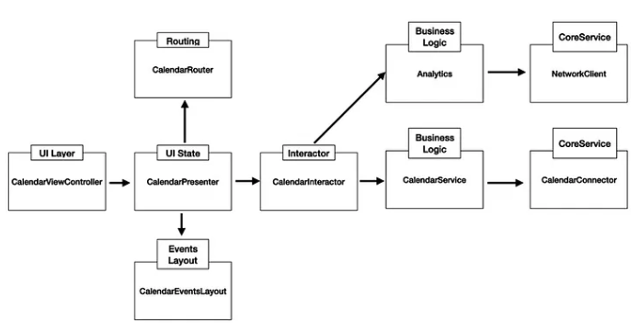
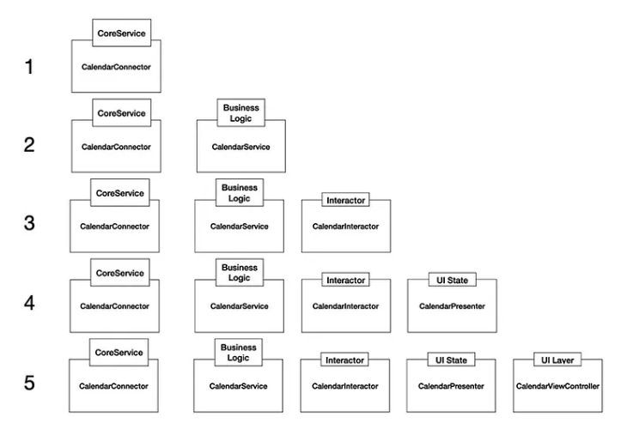
Bottom up vs. Top-Down

Slide 67
Regression Test
When software is modified, a regression test is used to check that modifications behave as intended and do not adversely affect the behavior of unmodified code.
After every change, however small, rerun the entire testing suite.

Slide 68
Regression Test
Collect a suite of test cases, each with its expected behavior.
Create scripts to run all test cases and compare with expected behavior. (Scripts may be automatic or have human interaction.)
When a change is made to the system, however small (e.g., a bug is fixed), add a new test case that illustrates the change (e.g., a test case that revealed the bug).
Before releasing the changed code, rerun the entire test suite
Often comes with Smoke Test
Quickly go through the suite of basic test cases
Make sure that the software under testing is ready or stable for further testing

Slide 69
Continuous Integration (CI)
Build and test whole systems regularly
Discover issues earlier
Reduce integration pain through automation and isolation of issues
Test beyond single developer's resources
Eliminate reliance on developers' discipline
Continuously monitor readiness of code
Applies to both development and release
Continuous build+test
Continuous delivery

Slide 70
CI Decisions
How to compose systems along release workflow
Which tests to run when along release workflow
Typical Setup
Pre-submit test suite gates all merges
Compilation and fast tests relevant to affected code
Post-submit test suite verifies subset of commits on trunk
Contains larger, more integrated tests
Release promotion pipeline verifies candidates for release
Contains even larger tests, may require dedicated resources

Slide 71
Automation, Speed, & Infrastructure
Tests must be automated and reliable
Ideally completely reproducible
Most steps must be fast to avoid impeding productivity
Cache build products
Skip unaffected tests
Parallelize & invest in compute resources
Benefits from tooling
Integration with version control and code review
Pre-merge and pre-release gates
"Last-known-good" branch (new work should branch from here, not trunk)
Bisect breakages
Log all results
Automatically rerun flaky tests

Slide 72
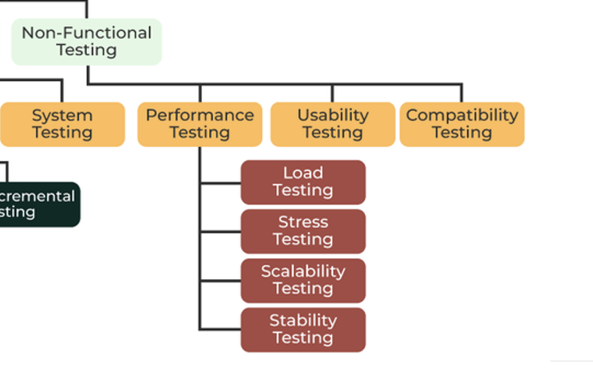
Non-Functional Test
Performance Test
Ensures software applications perform properly under their expected workload
Usability Test
To understand whether the machine is ready to come on the market
Compatibility
To check its compatibility (running capability) on different platforms/environments.

Slide 73
Performance Bug
Does not meet deadlines / satisfy SLA
Responsiveness, smoothness do not meet requirements
100 ms: GUI
15-30 ms: Animation (30-60 fps)
10 ms: MIDI, VR
Unexpected slowdown for certain inputs / DoS vulnerability
Performance regression (gradual and acute degradation)
Performance variability across platforms
Sub-optimal throughput for HPC

Slide 74
Performance Test
Load Test
Response of the system measured under varying load conditions
For normal and extreme load conditions.
Simulates a real-world load on a system to see how it performs under stress.
Identify bottlenecks and determine the limits the system can handle.
Ensure that the system can handle the expected usage levels

Slide 75
Performance Test
Stress Test
Given unfavorable conditions to the system and check how it perform in those conditions.
designed to test the run-time performance of software within the context of an integrated system
It is used to test the speed and effectiveness of the program

Slide 76
Performance Test
Scalability Test
Test the capability to scale up or scale down the number of user request load or other such performance attributes.
It can be carried out at a hardware, software or database level.
Ensures that a software product can manage the scheduled increase in user traffic, data volume, transaction counts frequency, and many other things
Stability Test
Checks the quality and behavior of the software under different environmental parameters and over time without failure.

Slide 77
Performance Test Challenges
How much room for improvement is there?
Amdahl's law: Limits to speedup from parallelization, local optimization
Roofline analysis: Do you expect to be limited by bandwidth or compute?
Is slowdown localized, dispersed, or emergent?
Getting reliable measurements is difficult
Inconsistency, load dependency, JIT compilation, non-representative datasets
Average case vs. worst case
Tension between latency and bandwidth

Slide 78
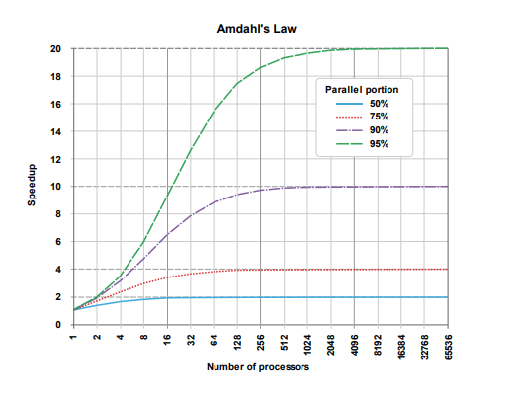
Amdahl's Law
Speedup: S = T_before / T_after
Identify portion p of runtime cost amenable to optimization
T_before = p*T + (1 - p)*T
Let s be speedup of optimization on this portion
Example: s = 10 for parallelizing on a 10-core machine
Often interested in limit as s → ∞
T_after = p*T/s + (1 - p)*T
S(s) = 1/(1 - p + p/s)
S → 1/(1 - p)

Slide 79
Profiling
How can we estimate p? Where should our optimization efforts be focused?
Profiling Techniques
Sampling: Periodically interrupt process and examine stack trace
Low overhead
Incomplete data
Tracing: Record whenever a function is called or returns
High overhead
Complete function counts
Timing may be distorted
Instruction-level: Estimate cost of each statement
Requires CPU model

Slide 80

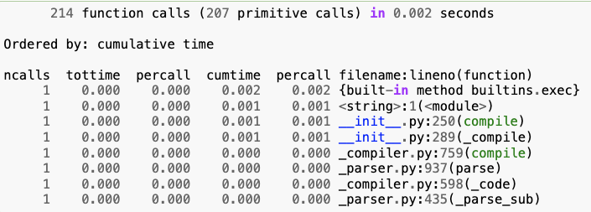
Profiling Tools
Profiling Techniques
Native code
perf (Linux)
gprof
callgrind
Python
cProfile
Java
JProfiler
VisualVM
NetBeans
Ncalls: for the number of calls
Tottime: total time spent in the given function
Percall: quotient of tottime divided by ncalls
Cumtime: cumulative time spent in this and all subfunctions
Percall: the quotient of cumtime divided by primitive calls
Filename: lineno(function)provides the respective data of each function

Slide 81
Monitoring
To detect degradation and catch regressions, need to log and monitor performance metrics
Can measure duration of tests in CI, but benefits from unloaded servers
For services, also need to monitor performance in production
Network conditions, load are dynamic
With scalable microservice architectures, counterintuitive bottlenecks may appear Scaling the wrong components can remove beneficial backpressure

Slide 82
Latency vs. Throughput
Latency: Duration between a single trigger and the system's response
"Tail latency" (e.g. 95th percentile under a specified load) is more important than average
Throughput: Time it takes to processes a fixed amount of work
Often a function of workload
Typically throughput increases with workload size up to a saturation point
Reduce overhead with batching
Typically at expense of latency

Slide 83
Documentation of Testing
Every project needs a test plan that documents the testing procedures for thoroughness, visibility, and for future maintenance.
The test plan should include:
Description of testing approach.
List of test cases and related bugs.
Procedures for running the tests.
Test analysis report.

Slide 84
SQLite: An Example
https://www.sqlite.org/testing.html
640x more test code than application code
Four independently developed test harnesses
100% branch test coverage in an as-deployed configuration
Millions and millions of test cases
Out-of-memory tests
I/O error tests
Crash and power loss tests
Fuzz tests
Boundary value tests
Disabled optimization tests
Regression tests
Malformed database tests
Extensive use of assert() and run-time checks
Valgrind analysis
Undefined behavior checks
Checklists

Slide 85
Fixing Bugs
Isolate the bug
Intermittent --> repeatable
Complex example --> simple example
Understand the bug and its context
Root cause
Dependencies
Structural interactions
Fix the bug
Design changes
Documentation changes
Code changes
Create new test case

Slide 86
Moving the Bugs Around
Fixing bugs is an error-prone process
When you fix a bug, fix its environment.
Bug fixes need static and dynamic testing.
Repeat all tests that have the slightest relevance (regression testing).
Bugs have a habit of returning
When a bug is fixed, add the failure case to the test suite for future regression testing.
Persistence
Most people work around a problem. The best people track down the root cause and fix it for ever

Slide 87
Difficult Bugs
Some bugs may be extremely difficult to track down and isolate. This is particularly true of intermittent failures.
A large central computer stops a few times every month with no dump or other diagnostic.
A database load dies after running for several days with no diagnostics.
An image processing system runs correctly, but uses huge amounts of memory.
Such problems may require months of effort to track down.
For a fictional example, see: Ellen Ullman, The Bug: a Novel, (Doubleday 2003).

Slide 88
Tracking Down a Difficult Bugs: The Heisenbug
A heisenbug (named after the Heisenberg Uncertainty Principle) is a computer bug that
disappears or alters its characteristics when an attempt is made to study it.
Timing While debugging, you run instructions line by line, the delay between operations might be orders of magnitude larger than in production (e.g., the interaction of different thread)
Memory During debug the addresses of variables might change (e.g., affect the precision used for floating point comparisons in some languages)
Assertions When your code is compiled with optimization options activated, assertions are usually disabled, while when compiling in dev mode locally they might likely be active. (Evaluating assertions might have side effects, e.g., timing)

Slide 89
Tracking Down a Difficult Bugs: The Heisenbug
Side-effects of debugging Adding logging or prints change the likelihood of the "wrong" interleaving between threads; the expressions checked in the debug's watches can have the same result, or even worse (if you are not careful) have side effects.
Latency If you are running debug locally, or with mocked services, the latency of sync calls will be orders of magnitude smaller.
Race conditions Execution depends on operating systems, and on the resources available at runtime. Many of these bugs only happen when certain edge conditions are faced.
Randomization Using randomization in your code might cause inconsistencies across different runs, including the happening of bug

Slide 90
When Fixing a Bug Creates a Problem for Customers
Sometimes customers will build applications that rely upon a bug. Fixing the bug will break the applications.
The graphics package with rotation about the Z-axis in the wrong direction.
An application crashes with an emulator, even though the emulator is bug free. (Compensating bug problem.)
The 3-pixel rendering problem with Microsoft’s Internet Explorer.
With each of these bugs the code was easy to fix, but releasing it would have caused problems for existing programs.

Slide 91
A Note on Testing User Interfaces
User interfaces need several categories of testing.
During the design phase, user testing is carried out with trial users to ensure that the design is usable. Design testing is also used to develop graphical elements and to validate the requirements.
During the implementation phase, the user interface goes through the standard steps of unit and system testing to check the reliability of the implementation.
Finally, acceptance testing is carried out with users, on the complete system.

Slide 92
03
PART THREE
Acceptance Testing & Delivery

Slide 93
Acceptance Testing
Acceptance testing
The complete system, including documentation, training materials, installation scripts, etc. is tested against the requirements by the client, assisted by the developers.
Each requirement is tested separately.
Scenarios are used to compare the expected outcomes with what the system does.
Emphasis is placed on how the system handles problems, errors, restarts, and other difficulties.
Is the system we have built, the system that you wanted? Does it meet your requirements?

Slide 94
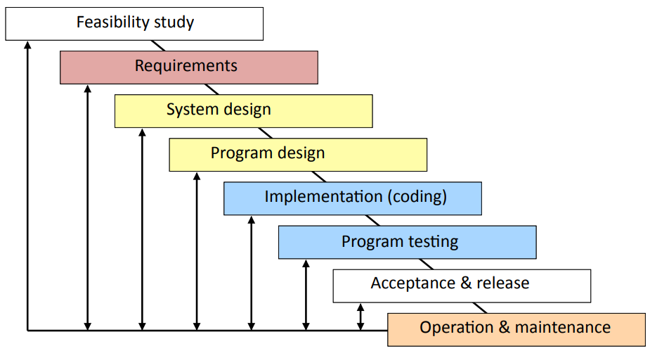
Acceptance Testing in the Modified Waterfall Model

Slide 95
Acceptance Testing with Iterative Development
Iterative development
If the client is properly involved in the development cycle:
The client will have tested many parts of the system, e.g.,
At the end of each iteration
During user testing
Problems and suggestions for improvement will have been incorporated into the system.
BUT: There must still be an acceptance test of the final system before it is released.

Slide 96
Acceptance Testing with Agile Development
Incremental development
Acceptance testing is particularly important with agile development, since each sprint should end with completed code that is ready for release.
Each sprint should be a complete development process, ending with acceptance testing by the client and release.
If several sprints build on each other, each sprint may need to repeat the acceptance tests for earlier sprints to check that they are still met.

Slide 97
Resources for Acceptance Testing
Acceptance Testing is a important part of a software project.
It requires time on the schedule.
It may require substantial investment in test data, equipment, and test software.
Good testing requires good people.
Help systems and training materials are important parts of acceptance testing.

Slide 98
Acceptance Tests
Closed box by the client without knowledge of the internals.
The entire system is tested as a whole.
The emphasis is on whether the system meets the requirements.
The tests should use real data in realistic situations, with actual users, administrators, and operators.
The acceptance tests must be successfully completed before the new system can go live or replace a legacy system.
Completion of the acceptance tests may be a contractual requirement before the system is paid for.

Slide 99
Techniques for Release
The transition from the previous version of a production system to a new release is challenging.
Parallel Testing:
Clients operate the new system alongside the old production system with same data and compare results.
Alpha Testing:
Clients operate the system in a realistic but non-production environment
Beta Testing:
Clients operate the system in a carefully monitored production environment
A/B Testing:
Comparing two versions of a system against each other to determine which one performs better

Slide 100
Release: Parallel Testing
Parallel Testing
For data processing systems, such as financial systems, payroll, etc., the old and the new systems are run together for several productions cycles to check that the new system replicates the functionality of the old.
Requires two sets of everything (staff, equipment, etc.).
Requires software to control changeover (e.g., do not mail two sets of payments).
Requires automated scripts to compare results.
May take several months. Often, the new system will be brought into production in phases.

Slide 101
Release: Alpha and Beta Testing
Alpha testing can be done with software that lacks some functionality. Beta testing requires fully functional system.
Alpha and Beta testing must be managed.
If you simply make versions of the software available to clients:
Many clients will never use it.
Other clients will use a few features.
Only a few clients will test it systematically.
Only a few clients will report problems systematically.
What incentives can you give clients to test your software for you?
Financial (e.g., discounts on products)
Prestige (e.g., recognition, publicity)

Slide 102
Release: A/B Testing
In an A/B test, you take a webpage or app screen and modify it to create a second version of the same page.
Half of your traffic is shown the original version of the page (known as control or A) and half are shown the modified version of the page (the variation or B).
As visitors are served either the control or variation, their engagement with each experience is collected and analyzed through statistical analysis.
Developers can then determine whether changing the experience (variation or B) had a positive, negative or neutral effect against the baseline (control or A).

Slide 103
Delivery
A good delivery package results in:
happy client
happy users
less expense in support and maintenance
But many projects rush the packaging, help systems, and training materials, give them to the least experienced members of the team, do not test them properly, and generally neglect this part of the software process.

Slide 104
Delivering the System
The best is the enemy of the good
No system is ever perfect.
If you insist on perfection:
you will never release anything
you will still never reach perfection (because the ultimate test comes from the users)
Learn what is essential to satisfy the client and focus on it.

Slide 105
Delivering the System
Pressures to get products to market and in operation often lead to bad decisions.
Trade-offs must be made between the cost of packaging, future support and maintenance, and the risk of later problems.
All are expensive, but, in my experience, the pain of being late is usually less than the pain of putting a bad system into operation.
Different categories of software product need different packaging and delivery procedures.

Slide 106
Delivery of Software
Packages that are shrink-wrapped or downloaded over the Internet
Installation scripts
automatic
varieties of hardware and operating systems
uninstall, reinstall, etc.
Support (very expensive if it requires staff)
training
documentation (user, system administrator, expert user)
Maintenance
client does not have source code
no bug fixing except with new release

Slide 107
Delivery of Software
Data processing system
Acceptance
Acceptance period may cover several months.
Client should be comfortable with complete system.
Support
Client should be self-sufficient.
Documentation and training for system administrators and operators.
Well organized source code for maintenance.
Maintenance and support contracts.

Slide 108
Delivery of Software
Embedded system
Acceptance
Hardware and software developed together.
Acceptance tests are a combination.
Maintenance
Bug fixes may require servicing the hardware.
Errors may be expensive or dangerous.
Support
Training for support personnel.
Documentation and training for users.

Slide 109
Training and Usability
A well-designed system needs less training:
good conceptual model
intuitive interfaces
Different skill levels need different types of training:
Skilled users work from the conceptual model.
Less-skilled users prefer cookbook sets of instructions.
Occasional users will forget complex details, but remember general structure.

Slide 110
Help Systems
Resources
A good help system is a major sub-project (time-consuming, expensive).
A good help system saves user time and support staff (time-saving, cost-saving).
Help system design
Users need many routes to find information (index by many terms, examples, mini-tutorials, etc.).
Help systems need to be tested with real users.

Slide 111
Categories of Documentation
Software development
Requirements, design
Source code, test plans and results
User
Introductory (various audiences)
User manual
Web site of known problems, FAQ, etc.
System administrator and operator
System manuals
Business
License, contract, etc.

Slide 112
Installation Tools
Creating installation scripts may be a major sub-project.
Different scripts, tools, and procedures for different categories of software.
Testing must be extensive with real users in their own environment

Slide 113
Delivery: Maintenance
Most production programs are maintained by people other than the programmers who originally wrote them.
What factors make a program easy for somebody else to maintain?
What factors make a program hard for somebody else to maintain?

